Slide 1
PARTNERS in ISLAND EDUCATION

Slide 2
PIE’s Mission
Partners in Island Education provides educational and cultural opportunities for the community of Vinalhaven
In-School Enrichment Programs
Perspectives After School
Summer SCAMPS
Scholarships for college, travel and education

Slide 3
PIE’s Scholarships
Vinalhaven College Scholarship
$2000 per year for 4 years to attend a 4-year college
Ogden-Chaffey Scholarships
$1000 one-time award to attend a post-secondary educational program or college
Travel & Education Scholarships
Awards of up to $2500 for travel and educational programs
Experiment in International Living Scholarship
$5000 award for an international summer travel program through EIL

Slide 4
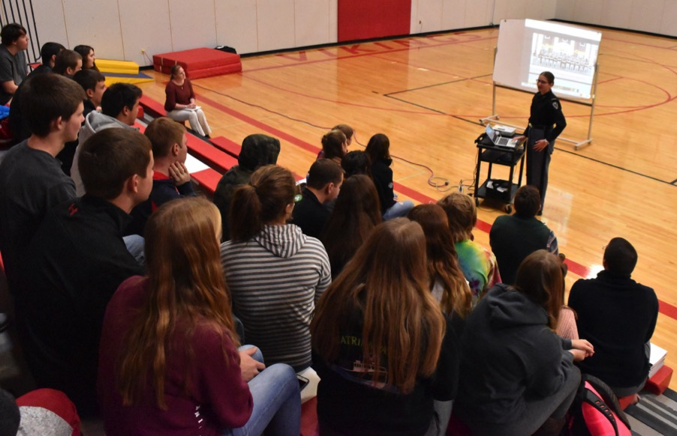
PIE scholarship students share their experiences with other students.

Slide 5
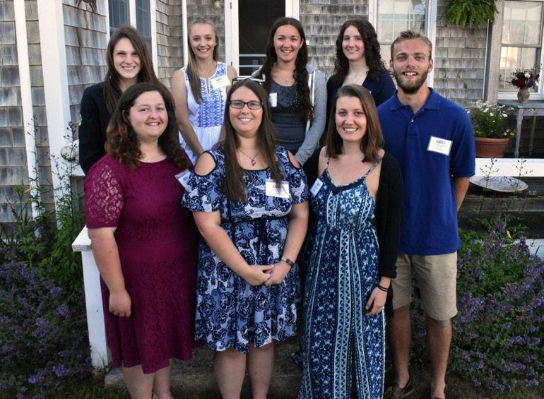
PIE Scholarship Recipients at the Liebers’ Annual Celebration in 2017

Slide 6
Meet some of our PIE Scholarship Recipients…

Slide 7
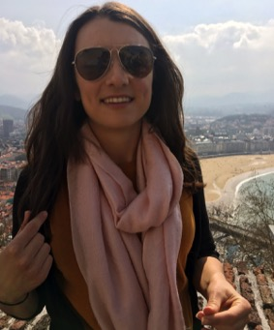
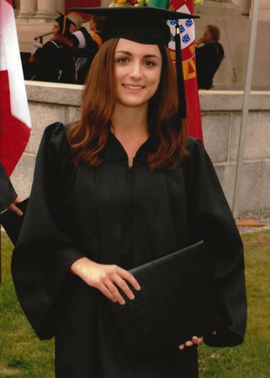
Emma Rosen
Vinalhaven College Scholarship
2007
Emma graduated Bowdoin College in 2011 with degrees in English and Education. She taught high school English in Watertown, MA, and then in Spain, before returning to Boston, where she is a graduate student in Social Work at Boston College. On receiving her MSW, Emma plans to be a School Adjustment Counselor and work with immigrant students.

Slide 8
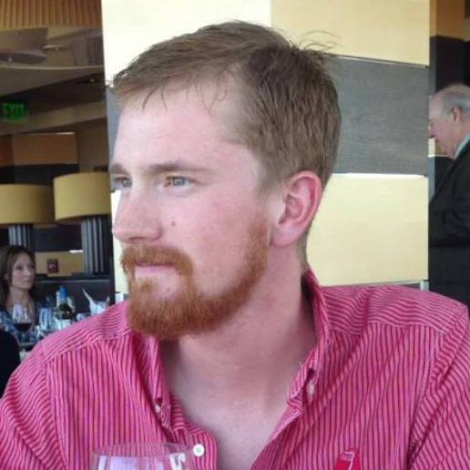
Ladd Olson
Vinalhaven College Scholarship
2009
Ladd Olson graduated from Maine Maritime Academy in 2013. He now splits his time between working for the International Organization of Masters, Mates & Pilots and lobstering from his boat in Vinalhaven. He recently spent several months working and teaching in the Mediterranean aboard the Maine Maritime Academy vessel, T.S. State of Maine.

Slide 9
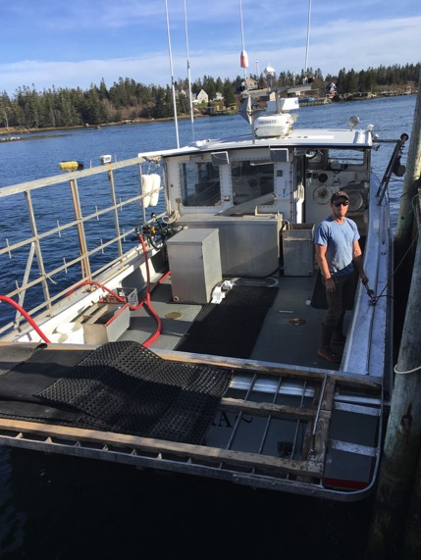
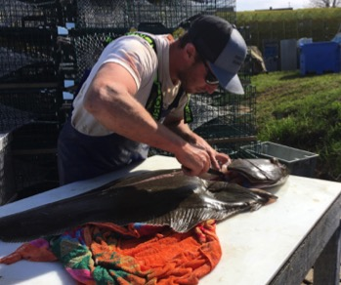
Sam spent a gap year in Tasmania and graduated from College of the Atlantic in 2013, with a degree in Marine Science, Law & Policy. He currently lives on Vinalhaven and fishes on his boat, the Minnamura. Sam serves on the board of the Vinalhaven Lobstermen’s Coop.
Sam Rosen
Vinalhaven College Scholarship, 2008

Slide 10
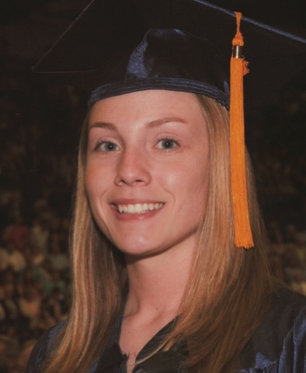
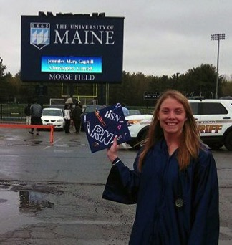
Jen graduated from UMaine, Orono in 2014 with a degree in Nursing. She now works as a nurse at the Islands Community Medical Center on Vinalhaven. She is married to Andrew Guptill.
Jen Guptill
Ogden-Chaffey Scholarship
2010

Slide 11
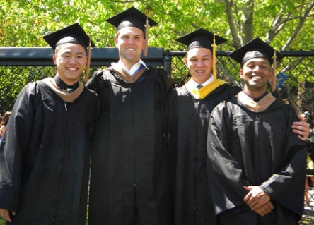
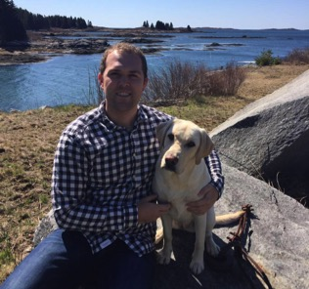
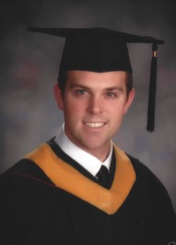
Nathan Hopkins
Vinalhaven College Scholarship
2010
Nathan graduated from Bentley College in 2014, and worked for several years in the Boston area as a Digital Traffic Coordinator and Data Operations Specialist. In 2017, he moved to New York City to become a Research Analyst at APlusA.

Slide 12
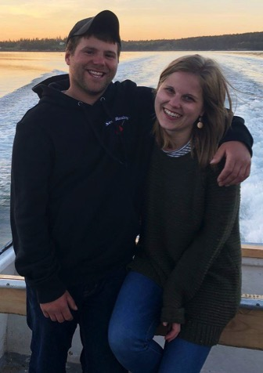
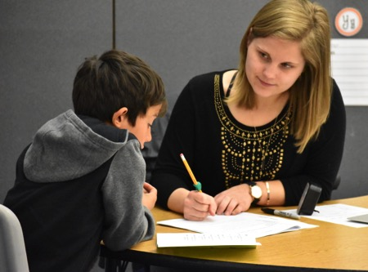
Blake Reidy
Vinalhaven College Scholarship
2012
Blake graduated from University of New England in 2016 with a degree in
Early Childhood Education. She now teaches 3rd grade at Vinalhaven School and is engaged to Bobby Beckman.

Slide 13
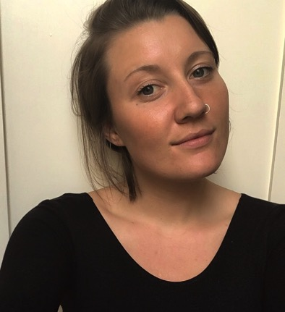
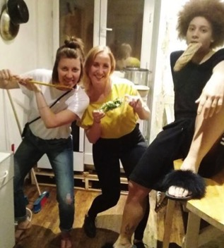
Izza Drury
Ogden-Chaffey Scholarship
2012
Izza Drury graduated Brown University in 2017, and spent the following year abroad, volunteering at a Women's Center for Refugees on the island of Chios, Greece. She also lived in Paris, studying French and volunteering at a shelter for refugee minors. Izza recently started a job as a Grassroots Field Organizer with the Maine Democrats in the Portland, Maine area.

Slide 14
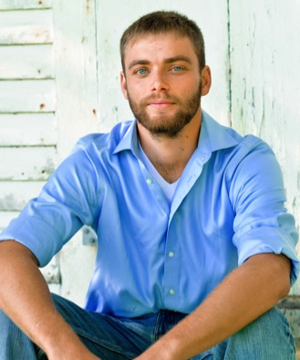
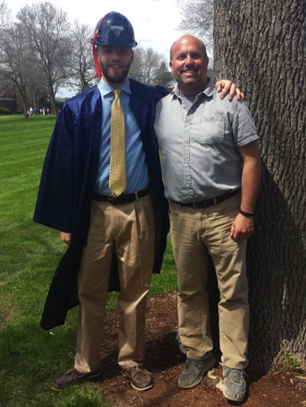
Trey Warren
Additional (one-time) Scholarship, 2012
Trey graduated from UMaine, Orono in December 2017 with a degree in Civil Engineering. In April he accepted a job offer from Gorrill Palmer Engineering in Portland, Maine as a Design Engineer in their Transportation Group. He is currently living in Falmouth Foreside and enjoying his new job.

Slide 15
Hunter Smith
Ogden-Chaffey Scholarship 2014
Hunter Smith graduated from SMCC in December, 2016 with an associate degree in Criminal Justice. He worked for the Scarborough Police Depart-ment as a reserve officer, and now works full time for the Buxton Police Department. Hunter will be attending the Maine Criminal Justice Academy later this year.

Slide 16
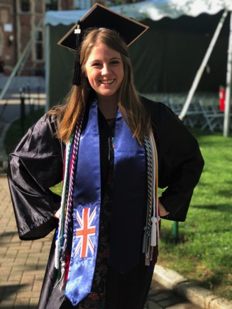
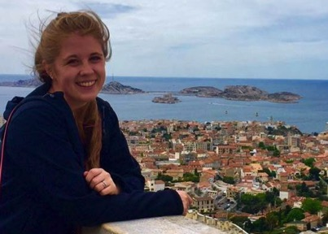
Ellie Reidy
Vinalhaven College Scholarship
2014
Ellie finished her thesis on The Effects of Diethyl Phthalate on Drosophila Melanogaster Development last spring, and graduated from Wagner College, magna cum laude in June 2018. This summer she started medical school at University of New England to become an osteopathic physician.

Slide 17
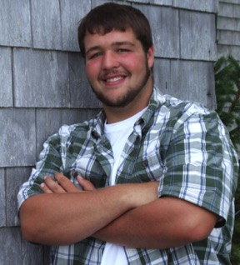
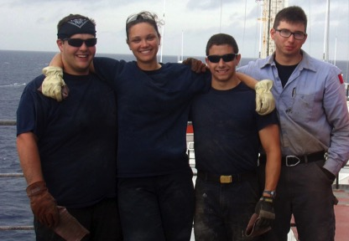
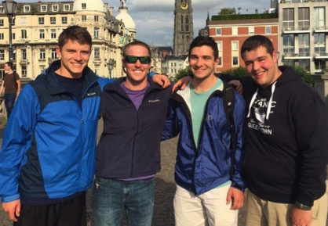
Everett Webster
Vinalhaven College Scholarship 2015
Everett has been attending Maine Maritime Academy. He has traveled to to Northern Europe twice and just finished his final training cruise aboard the T.S. State of Maine in the Mediterranean including stops in Portugal, Italy, and Spain.

Slide 18
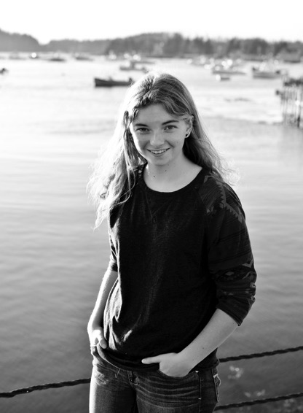
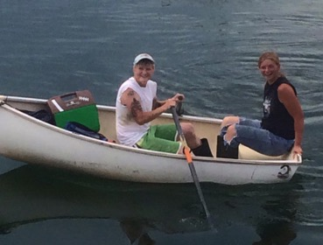
Ruby Hopkins
Ogden/Chaffey Scholarship
2015
Ruby studied at UMaine, Orono.
She currently goes lobstering with Yvonne Rosen on the Gimme a Hulla.

Slide 19
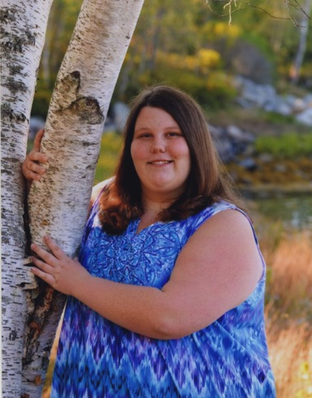
Zoey Warren
Ogden/Chaffey Scholarship
2016
Travel & Education Scholarship, 2013-4: People to People Ambassador Program
Zoey attends Southern Maine Community College, studying Early Childhood Development, with plans to graduate in May 2019.

Slide 20
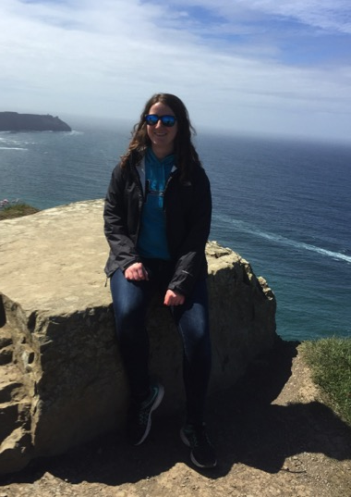
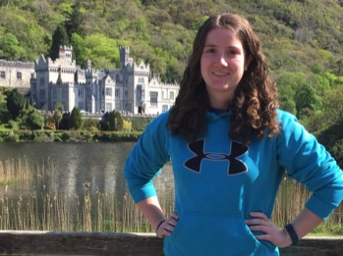
Taylor Littlefield
Vinalhaven College Scholarship
2015
Taylor will enter her senior year at University of New England this Fall. She was inducted this spring into the Alpha Chi National Honor Society, and recently passed her GRE exams, allowing her to apply to graduate schools to study Physical Therapy upon graduation.

Slide 21
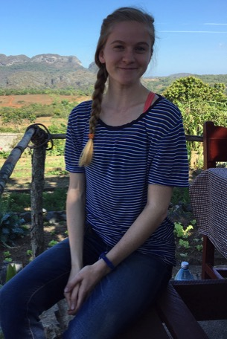
Hannah Noyes
Vinalhaven College Scholarship
2016
Travel & Education Scholarship,
2014-15: Traveling School Semester
Hannah Noyes just finished her sophomore year at Connecticut College, where she is majoring in History with a focus in Latin American Studies. This spring she spent 10 days in Cuba as part of a class in Modern Latin American History. She was also chosen captain of her cross country team and made the Dean’s List!

Slide 22
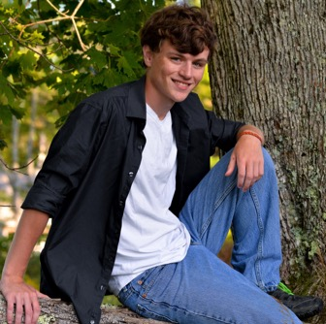
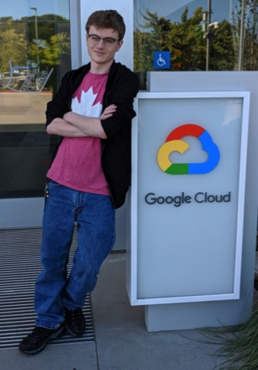
Trevor Farrelly
Vinalhaven College Scholarship, 2016
Travel & Education Scholarship, 2013-14: Envision: Engineering & Technology
Trevor Farrelly attends Rensselaer Polytechnic Institute. This summer, he is participating in a 12-week internship at Google in Sunnyvale, California.

Slide 23
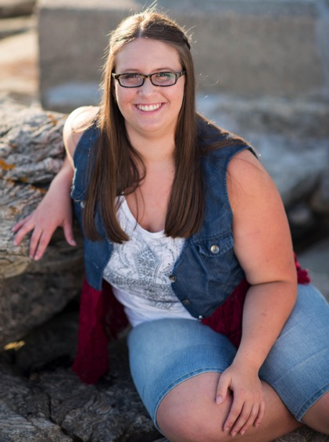
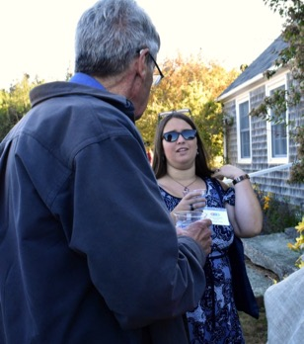
MaKenzie Young
Vinalhaven College Scholarship, 2016 Travel & Education Scholarship, 2013-14: National Youth Leadership Forum
MaKenzie attends Champlain College.

Slide 24
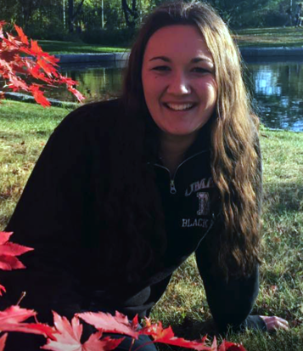
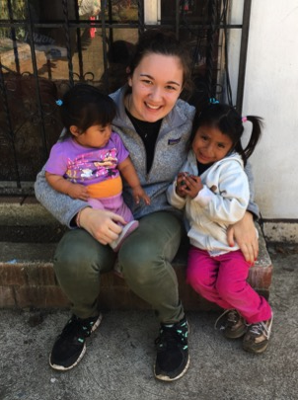
Andrea Shane
Ogden/Chaffey Scholarship, 2016
Travel & Education Scholarship, 2015-16: Volunteer work in Guatemala
Andrea took a gap year after graduating VHS and spent 5 months doing volunteer work in Guatemala through International Volunteer Headquarters. She worked with children and with Antigua Exotic, an animal rescue center. She currently attends UMaine, Orono.

Slide 25
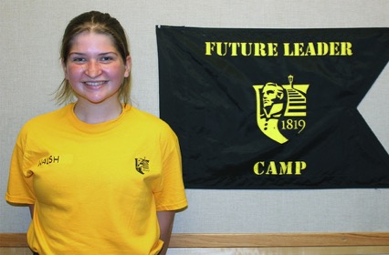
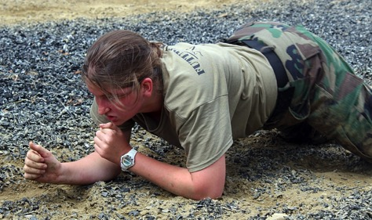
Polina Walsh
Vinalhaven College Scholarship, 2017: Norwich University
Travel & Education Scholarship, 2016-7: Future Leader Camp, Norwich University
Polina recently finished her first year at Norwich University, where she participated in the ROOKS (first year recruits unit) and underwent 18 weeks of strenuous military-style training, while balancing college studies.

Slide 26
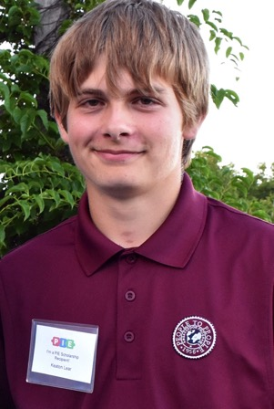
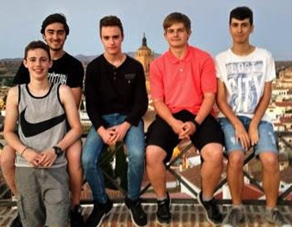
Keaton Lear
Travel & Education Scholarship, 2014-15: People to People Program
PIE/Experiment in International Living Scholarship, 2017: Language and Regional Cultures of Spain
Keaton will graduate from VHS in 2019.

Slide 27
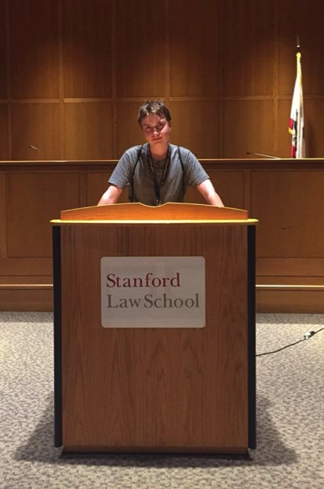
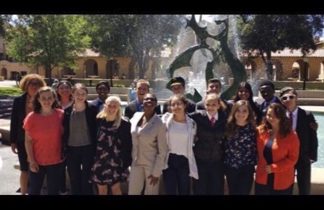
Jackson Day
Travel & Education Scholarship, 2018: Envision: Intensive Law & Trial Program, Stanford University
Jack will graduate VHS in 2020.

Slide 28
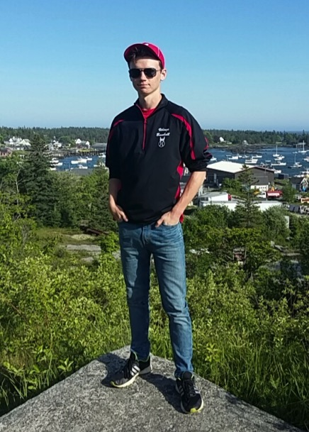
Tim Farrelly
Travel & Education Scholarship, 2017-18: Putney Student Travel, Nepal Community Service Program in July 2018.
Tim will graduate from VHS in 2020.

Slide 29
Thank you for supporting PIE!

Slide 30
For more info and photos about PIE…
Visit our website:
PartnersinIslandEducation.org
Visit us on Facebook:
Partners in Island Education
Perspectives After School

